Slide 1
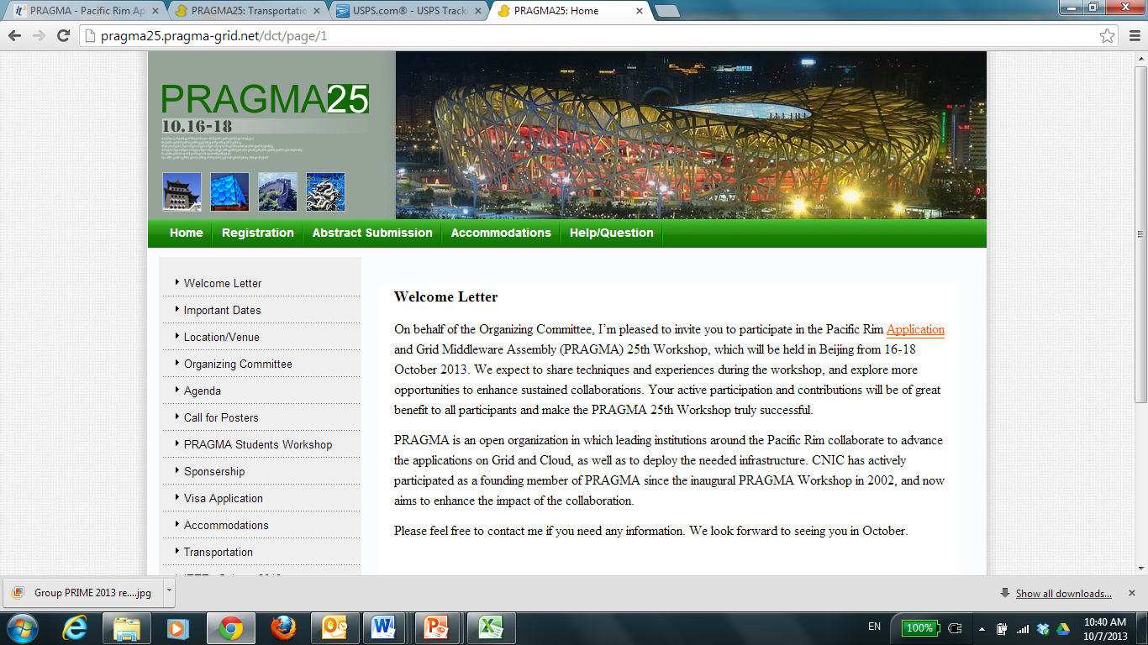
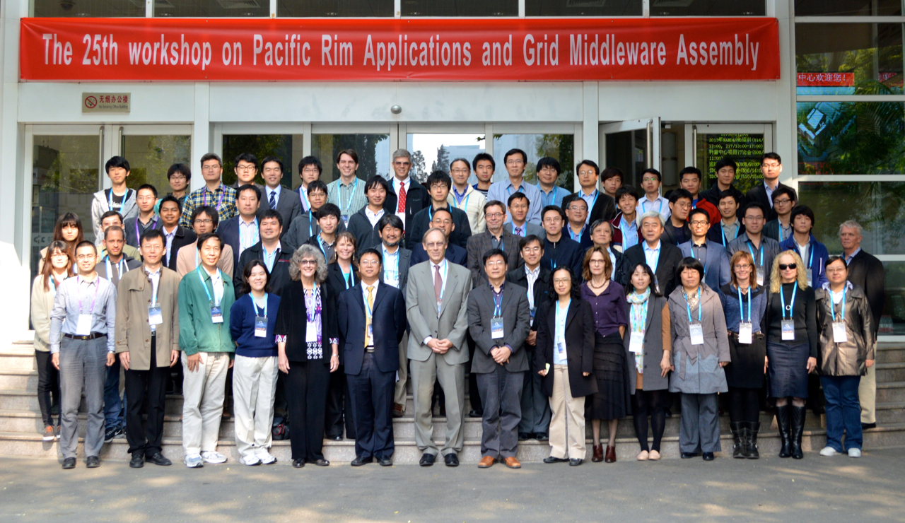

Slide 2
Summary of Steering Committee Meeting
2013 October 18

Slide 3
Subcommittees of Steering Committee
PRAGMA Students
Co-Chairs: Beth Plale, Karpjoo Jeong
Sustainability of PRAGMA
Chair: Jim Williams
Develop strategies and implementable approaches to
Align long-term nature of grad student research with short-term PRAGMA projects
Support (financially) graduate student participation on PRAGMA
Provide the networking, leadership, and research opportunities for students in PRAGMA
Review the issue of sustainability
Review/revise components on
Grow Leaders
Create funding models
Develop clearly defined products
Discuss and recommend strategies and implementable approaches that would help PRAGMA continue to be successful
Notes:
NOT FOR IEEE

Slide 4
Discussion Steering Committee
Students
Short term – funding
Change in meeting structure to engage students
Sustainability
Separate research and organizational/administration
Do something now but gradually
Need to have organizational vision (not an individual vision)
Specific recommendations
Conference fees
Transparency and expectation (if you pay fees)
PRAGMA has a character – we do not want to change the character by the changes
Professional Secretariat (Putchong’s example of society)
Costs estimate
Legal entity

Slide 5
Next Steps
Discuss / Implement Changes for Students
Look at different models of organizations *

Slide 6

PRAGMA’s Website
Notes:
It is time for a face lift – we are working on one now – that will reflect our PRAGMA Collaborative Overview
But this is your website – we welcome ideas for content

Slide 7

PRAGMA Collaborative Overview 2013 - 2014
Highlights
Demos you will see
PRAGMA Students
Community Building
Working Groups
Institutions and Sponsors
Finalized before SC13

Slide 8
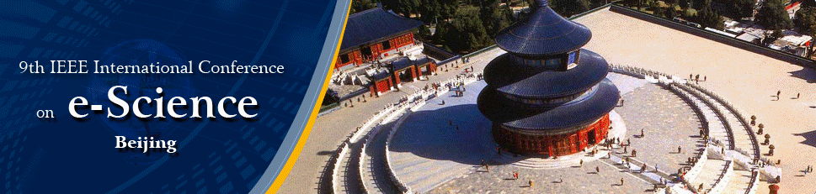
Talks by PRAGMA Participants
Oct 23: Wed. 1400 – 1530
A Computational- and Storage-Cloud for Integration of Biodiversity Collections, Andréa Matsunaga and others
Protein Structure Modeling in a Grid Computing Environment, Jason H. Haga
Oct 24: Thursday 1330 to 1500
Dependency Provenance in Agent Based Modeling, Beth Plale
Data Pipeline in Map Reduce, Beth Plale
Biomedical Research Data Cloud Services with Duckling Collaboration Library (CLB), Kevin Dong (10:30 am – 12 pm)
Oct 25: Friday. 1100 – 1130
PRAGMA: a Pacific-Rim collaborative for cyberinfrastructure research in support of scientific expeditions and building community, Jose Fortes
Developing Sustainable Data Services in CI for Higher Education – Wilfred Li (1100 – 1230)
Notes:
Committees: https://escience2013.csp.escience.cn/dct/page/65578

Slide 9
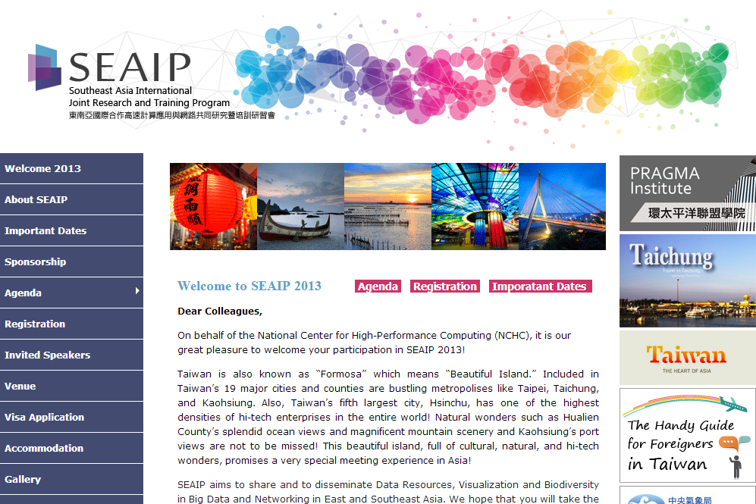
http://seaip.narlabs.org.tw

Slide 10


Slide 11
Future Events and Workshops
9th IEEE International Conference on e-Science
Beijing, October 22 – 25, 2013, hosted by Computer Network Information Center
SEAIP 2013: Southeast Asia International joint Research and Training Program; & PRAGMA Institute
Taichung, hosted by National Center for High-Performance Computing
http://seaip.narlabs.org.tw/
PRAGMA 26
April 9–11, 2014, Tainan Taiwan. Hosted by National Center for High-Performance Computing and National Cheng-Kung University (NCKU)
Special Session in conjunction with International Conference on Serpentine Ecology
June 12 or 14 2014, Sabah, Malaysia
http://www.icse2014.com/icse2014/
PRAGMA 27
October 15–17, 2014, Bloomington, Indiana USA. Hosted by Pervasive Technology Institute of Indiana University.
PRAGMA 28 ???

Slide 12
Thank You
General Chair:
Kai Nan (CNIC)
Program Committee:
Kejun Dong (CNIC, Chair)
Fang-Pang Lin (NCHC, Co-Chair, Chair of PRAGMA26) *
Yongzheng Ma (CNIC, Co-Chair)
Karpjoo Jeong (Konkuk University)
Sornthep Vannarat (NECTEC)
Reed Beaman (University of Florida)
Wing Keung Kwan (Hong Kong University)
Kohei Ichikawa (NAIST)
Yuan Luo (Indiana University)
Meilan Jiang (Konkuk University)
Yang Zhang (Lanzhou University)
Qing Ji (Tianjin Supercomputer Center)
Cheng-Zhong Xu (Wayne State University)
Zhibin Yu (SAIT, CAS)
Demo Chair:
Yongzheng Ma (CNIC)
Poster Chair:
Yuan Luo (Indiana University)
Student Workshop Organizing Committee:
Yuan Luo (Indiana University)
Meilan Jiang (Konkuk University)
Quan Zhou (Indiana University)
Yi Shen (CNIC)
Local Organization:
Fang Qian (CNIC)
Qiong Wu (CNIC)
Boyun Liu (CNIC)
Haibin Guo (CNIC)
Yi Shen (CNIC)
Yueda Wang (CNIC)
Student Volunteers
Wei Xie,
Kang Zhou,
Chao Yan,
Ren Yang,
Lei Cao,
Fucun Jiang

